Slide 1
AIR QUALITY MONITORING SYSTEM

Slide 2
Project analysis slide 2
Introduction
ANALYSIS
COMPONENTS
AQI
IMPLEMENTION
DESIGN
TESTING
DEVELOP

Slide 3
Project analysis slide 3
Introduction
COMPONENTS
DESIGN
DEVELOP
IMPLEMENTATION
TESTING
STM32 blackpill
Buck converter
PMS3003
CCS811
MQ 135
MQ 136
SHT 31
ESP 32
Designed a system to measure multiple pollutants, compute total AQI, and display gas-specific ppm with precise sensing, reliable processing, and efficient cloud updates.
Programmed STM32 firmware for sensor reading, AQI calculation, and ESP32 data transfer. Built a Flutter-based mobile app for real-time monitoring and visualization.
Mounted sensors and controllers on a compact Veroboard with optimized wiring, enabling ESP32-based seamless cloud integration and continuous data upload.
Tested the system in different environments, checking readings against reference instruments to ensure accurate AQI, stable sensors, and smooth cloud data flow.

Slide 4
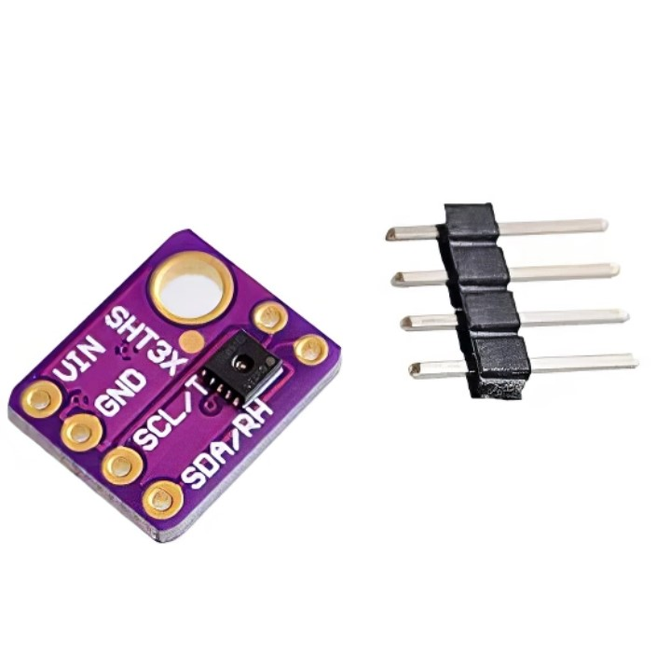
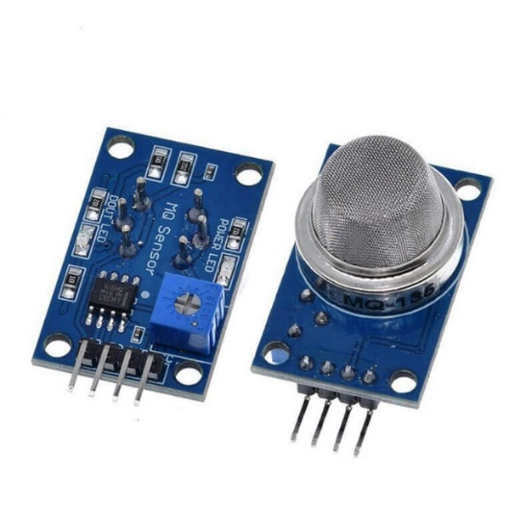
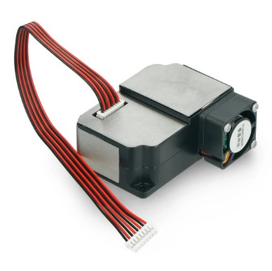
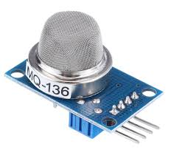
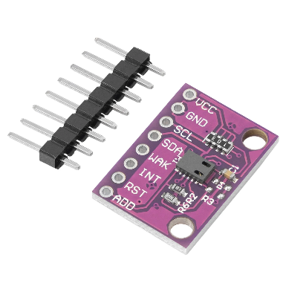
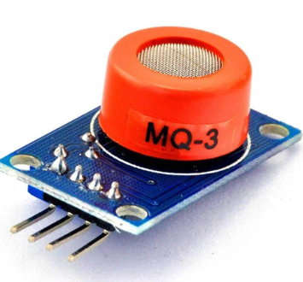
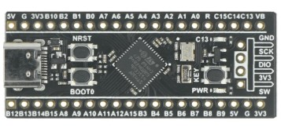
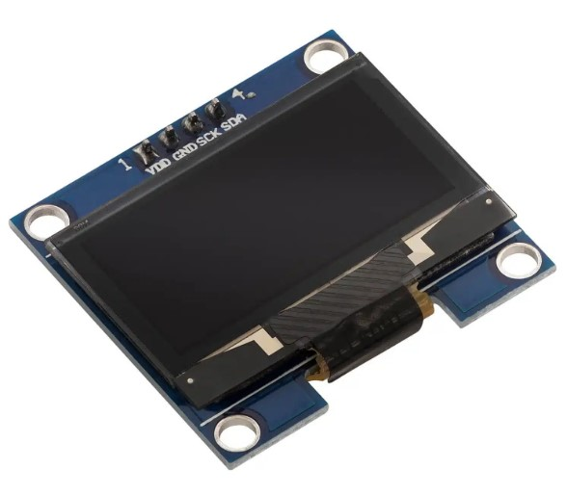

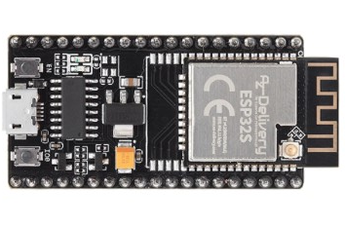
Project analysis slide 4
Block Diagram
SHT 31
MQ 135
MQ 136
CCS 811
PMS 3003
Tasks
Management Objectives
OLED
Project Objectives
Implementation Plan
Schedules
Firebase
STM 32 blackpill
Customer Objectives
Resources
ESP32 Node mcu

Slide 5
PMS 3003
Overview:
The PMS3003 is a laser-based particulate matter (PM) sensor that measures the concentration of particles
in the air, including PM1.0, PM2.5, and PM10. It is widely used in air quality monitoring systems
for real-time dust and particle detection.
Specifications:
Measurement Range: 0 – 500 µg/m³
Principle: Laser scattering with photodiode detection
Interface: UART (TTL level, 3.3V logic)
Supply Voltage: 5V DC (±0.1V)
Current Consumption: ≤ 100 mA
Response Time: ≤ 10 seconds
Output Frequency: 1 Hz (once per second)
Implementation & Interfacing:
VCC → 5V, GND → Ground
TX → MCU RX pin (3.3V logic level compatible)
RX → MCU TX pin (optional, for control commands)
Communicates over UART at 9600 bps
Data format: 32-byte frame with PM values in µg/m³
Measurement Ranges:
Features:
High precision and stability
Continuous data output without extra commands
Built-in fan for air sampling

Slide 6

CCS 811
Overview:
Detects Equivalent CO₂, TVOC, and various gases including alcohols,
aldehydes, ketones, organic acids, amines, and hydrocarbons.
I2C Communication & Registers:
I2C address: 0x5A (default) or 0x5B (ADDR pin high).
Status Register: 0x00 -> Check if the sensor is ready for measurement, and if new data is available.
Meas Mode: 0x01 -> Configure how often the sensor takes readings (e.g., 1/sec, 10/sec).
ALG Result Data: 0x02 -> Retrieve processed Equivalent CO₂ and TVOC values.
App Start: 0xF4 ->Switch the CCS811 from boot mode to application mode.
Calibration:
Initial Burn-in: 48 hours continuous operation when first received.
Warm-up Before Use: 20 minutes in desired modebefore each use.
Logic Pins (I2C Communication):
SCL: I2C clock (10K pull-up, 3–5V compatible).
SDA: I2C data (10K pull-up, 3–5V compatible).
INT: Interrupt output (3V logic).
WAKE: Pull to GND to activate sensor.
RST: Pull to GND to reset sensor.
Measurement Ranges:
Measurement Ranges:
eCO₂: 400 – 8192 ppm
TVOC: 0 – 1187 ppb

Slide 7
MQ 3
Overview:
The MQ-3 is a semiconductor gas sensor designed to detect alcohol vapor in air.
It is highly sensitive to ethanol and commonly used in breath analyzers, alcohol detectors, and safety systems.
Specifications:
Detection Range: 0.04 – 4 mg/L (20 – 2000 ppm)
Analog voltage proportional to gas concentration
5V (heater), ~150 mA current consumption
~20 seconds for stable readings
Calibration:
Calibrated in clean air to determine R₀ (baseline resistance).
Use ethanol vapor of known concentration to create a calibration curve
Warm-up sensor for 20 seconds before readings for stability
Implementation & Interfacing:
VCC → 5V, GND → Ground.
Used ADC to read analog voltage.
Convert ADC value to voltage -> resistance
-> ppm using calibration cure.
Displayed data on 1.3” OLED via I²C.
Measurement Ranges:
Applications:
Breath alcohol analyzers.
Alcohol detection in fermentation processes

Slide 8

MQ 135
Overview:
MQ-135 is a semiconductor gas sensor capable of detecting a wide range of harmful gases including
NH₃, CO₂, smoke, alcohol, benzene, and NOx. It is widely used in air quality monitoring systems.
Specifications:
Gas detection range: 10 ppm – 1000 ppm (varies by gas).
Analog voltage output proportional to gas concentration.
Power: 5V heater, low current (~150 mA).
Requires ~50 seconds warm-up for stable readings.
Non-selective sensor — detects multiple gases without individual identification.
Calibration:
Calibrated in clean air to determine R₀ (baseline resistance).
Warm-up of 50 seconds before reading.
Tested with alcohol and smoke; readings increased sharply.
Correct Calibiration resolved initial accuracies.
Implementation & Interfacing:
VCC → 5V, GND → Ground
Used ADC1 to read analog voltage.
Converted ADC reading → voltage → sensor resistance
→ ppm using empirical formulas.
Displayed data on 1.3” OLED via I²C.
Measurement Ranges:
Results:
Successfully interfaced with STM32.
Real-time display of multi-gas concentration.
Stable and reliable sensor output

Slide 9
MQ 136
Overview:
MQ-136 is a semiconductor gas sensor designed for detecting hydrogen sulfide (H₂S) gas
in concentrations from 1 ppm to 200 ppm. It is highly sensitive to H₂S and suitable for air quality monitoring,
industrial safety, and gas leakage detection applications.
Specifications:
Gas detection range: 1 – 200 ppm (H₂S).
High sensitivity and fast response to hydrogen sulfide.
Analog voltage output proportional to gas concentration.
Power: 5V heater, low current (~150 mA).
Initial Burn-in: ~24 hours continuous operation when first used (to stabilize sensitivity).
Before each measurement: ~1 – 2 minutes warm-up for stable readings.
Calibration:
Calibrated in clean air to determine R₀ (baseline resistance).
Warm-up of ~1 - 2 minutes before reading.
Compare readings to known H₂S concentrations for accuracy.
Implementation & Interfacing:
VCC → 5V, GND → Ground
Used ADC to read analog voltage.
Convert ADC value to resistance, then to ppm using
sensor’s sensitivity curve.
Displayed data on 1.3” OLED via I²C.
Measurement Ranges:
Applications:
Industrial safety systems
Air and environmental quality monitoring
Gas leakage detection in chemical plants

Slide 10
SHT 31
Overview:
The SHT31 is a high-accuracy digital temperature and humidity sensor from Sensirion.
It offers fast response, long-term stability, and is ideal for environmental monitoring applications.
Specifications:
Temperature Range: –40°C to +125°C
Temperature Accuracy: ±0.3°C
Humidity Range: 0% – 100% RH
Humidity Accuracy: ±2% RH
Interface: I²C (default address 0x44, optional 0x45)
Supply Voltage: 2.4V – 5.5V
Low Power Consumption with configurable measurement modes
Features:
High repeatability and stability over time.
On-chip heater to reduce condensation.
Measures and outputs temperature & relative humidity in real-time.
Fully calibrated and ready to use from the factory.
Implementation & Interfacing:
VCC → 3.3V or 5V, GND → Ground
SDA → MCU I²C data pin, SCL → MCU I²C clock pin
Communicates via I²C to read temperature and
humidity data registers
Supports clock stretching and CRC for data integrity
Measurement Ranges:
Applications:
Weather stations
HVAC systems
Air quality monitoring
Smart home devices

Slide 11

Project analysis slide 10
Final Product

Slide 12

Any Questions?

Slide 13
Thank You

